Slide 1
The ToolShed
Disciples of Dan
Karsten Boettcher, Connor Dibble, Tyler Green, and Mark Yamane

Slide 2
Overview
Design Decisions:
As a group we decided that we wanted to use the Django Framework to create this project. The decision was made based off prior experience and the many built in qualities that the framework has; for example, a Django project comes with SQLite already built in. This helped us achieve our own personal goals of making a higher quality web application while also being able to satisfy the most important requirements in the project. Django allows to have a database that holds all of our all of our tools, the checkout and check in information, and it allows us to use the built in Crispy Forms that allow the functionality of letting the employees log in and out of the web page.
In order to keep the html pages readable and organized Karsten came up with the idea to include a base html page that all other html pages could inherit from so that each page included the headers and footers of the web page. Once again we wanted to do our best to make a project that is something we could be proud of and this has helped us achieve that. It also is important because it holds the functionality of the navbar which is essential to navigating our web application.

Slide 3
Design Decisions Cont:
We decided to also use bootstrap in order to create our NavBar and the Carousel. One of our group members had previous experience using bootstrap and suggested that we use it because it is a clean and efficient way to create a NavBar and an Image Carousel. Using bootstrap was a good way for us to learn how to use a CSS Framework and also create a professional looking NavBar and Carousel.

Slide 4
Scrum Practices
Our group held weekly Sprint Retrospective meetings where we discussed our plans and goals for the week and set timelines for us to accomplish our goals. We also reviewed the previous weeks efforts and talked about areas that we could improve on as a team.
Because we weren’t all working on the project at the same time and it wasn’t necessarily every single day we created a Slack channel called #tasklist where we would list what we were currently working, on in order to prevent multiple people working on the same thing, and also add any other requirements that were necessary for the web page. This was our replacement for the Daily Standup Meetings.
We used our product backlog in order to properly plan and decide what tasks were most necessary to accomplish.

Slide 5
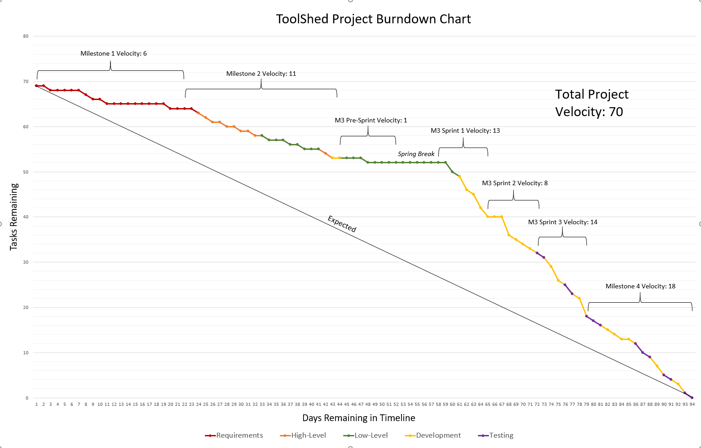
Burndown Chart

Slide 6
Deployment
We believe that our product is ready to enter deployment.
We have used unit tests in order to make sure that our database can properly create each tool and store the information about when people have checked tools out. Our unit tests test each part of our database to make sure the information has been properly stored.
We have done a lot of functional testing with our application to make sure that every piece of the application is working as intended.
We have taken great steps to make sure that our code is clean and organized and follows good coding practices.

Slide 7

Requirement 1
Shopping cart to check out the tools
Maximum of five tools per user per checkout.
When checking out tools enter the name of the person checking it out, date, and due date.
(From our Requirements Definition)
Must in MSCW
Functional in Furps
Tyler and Connor Mainly worked on the functionality of the cart

Slide 8
Design
Utilize a combination of Django models and views to create the cart.
Model holds the data (tools in cart, price, picture)
View handles the logic of rendering what is in the model and decrements/increments cart and tool category respectively.
Upon checkout, users are sent to a checkout confirmation page where they input their name and checkout the tools
The checked out tools are then sent to a checked out screen where the admin can see and check in the tools

Slide 9
Scrum Tasks
Make the shopping cart model with all applicable fields (Connor)
Write the initial view to utilize model to add to cart. Tool quantity should be decremented inside of the tool when added to cart. User can check out more than one tool of same category. (Connor)
Make the shopping cart uniform across all pages and have the info appear in a dropdown (Connor/Karsten)
Ensure no errors or undesired side effects f user refreshes on checkout page. (Tyler)
Make it so the user cannot checkout from tool categories with no available tools. (Connor)
Impose a limit of 5 tools per customer per checkout (Tyler)
Checkout confirmation screen (Tyler)
Cart styling and refactoring (Tyler and Karsten)

Slide 10
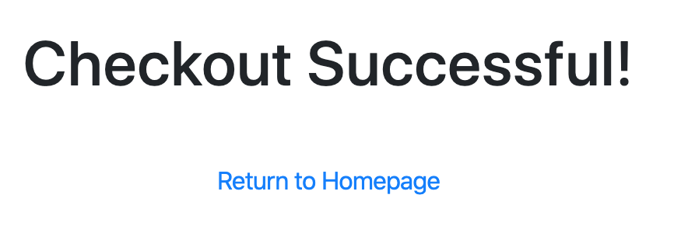
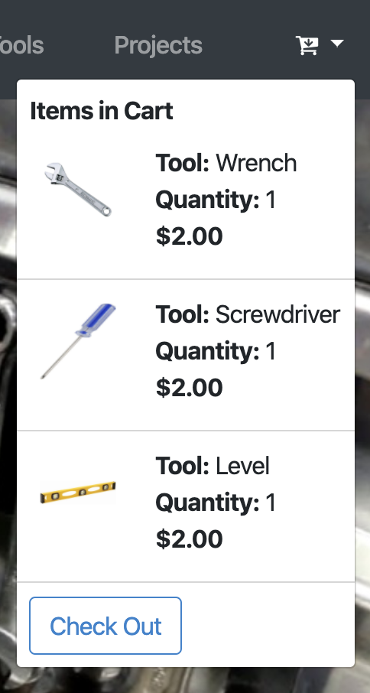
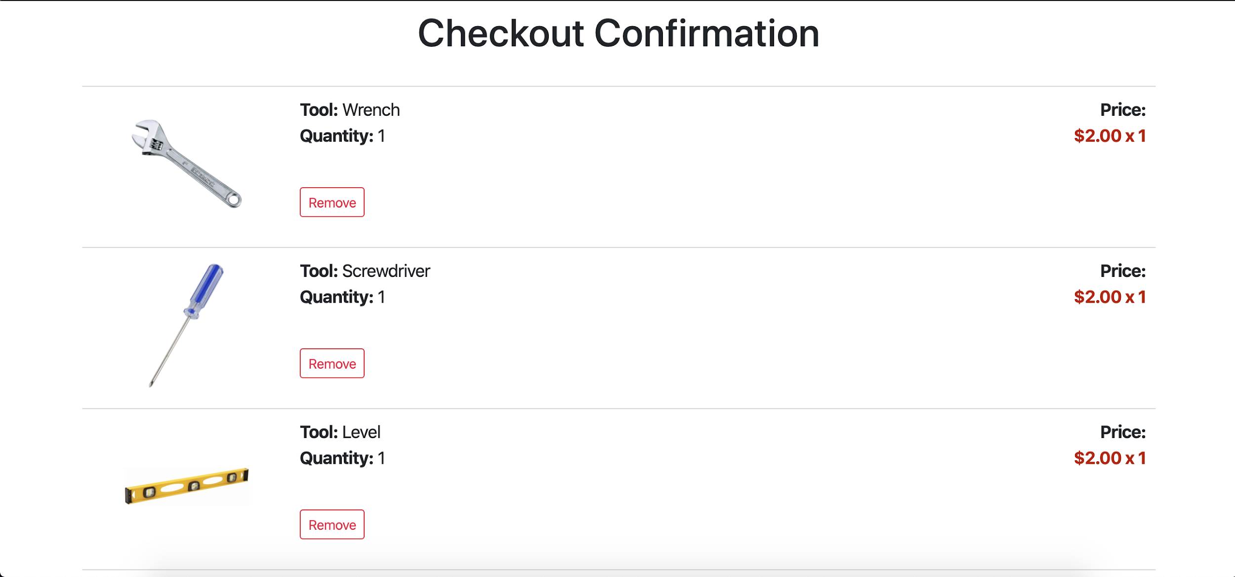

Slide 11
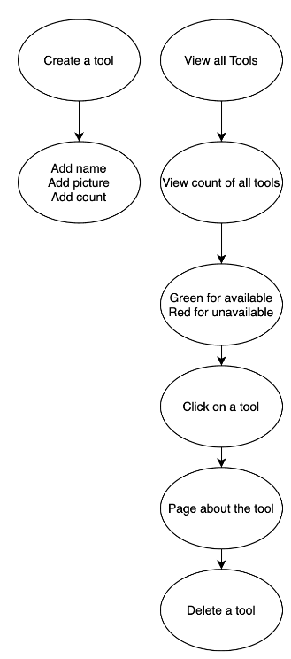
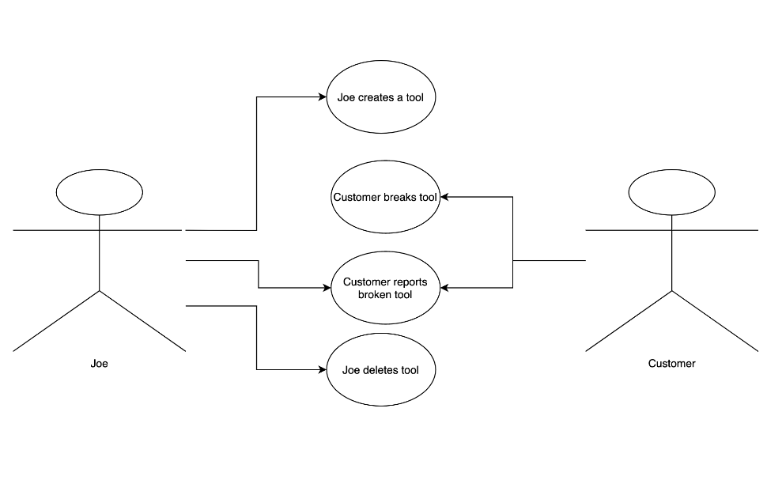
Requirement 2
Create, edit, and delete a tool
Furps: Functionality
Moscow: Must
The requirement is there must be a way on the website to create a tool, edit a tool, and delete a tool

Slide 12
Requirement 2
Documentation:
Requirements Definition:
https://github.com/connordibble/Tool-Co-op/blob/master/Docs/Requirements%20Definition%203.1.pdf
Sprint Planning:
https://github.com/connordibble/Tool-Co-op/blob/master/Docs/Sprint%20Planning_Retrospective%20Documents%20.pdf
Scrum Board:
https://github.com/connordibble/Tool-Co-op/blob/master/Docs/Scrum%20Board.txt
March 14, 2020
March 19, 2020
Github Issues:
https://github.com/connordibble/Tool-Co-op/issues/22
https://github.com/connordibble/Tool-Co-op/issues/24

Slide 13
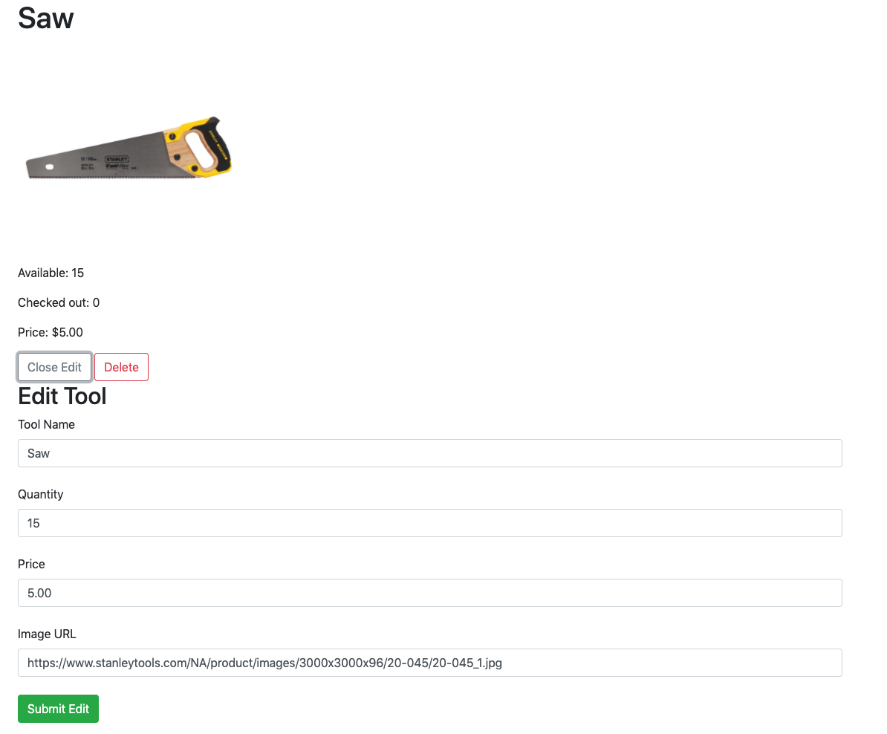
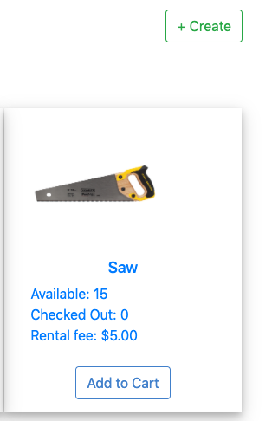
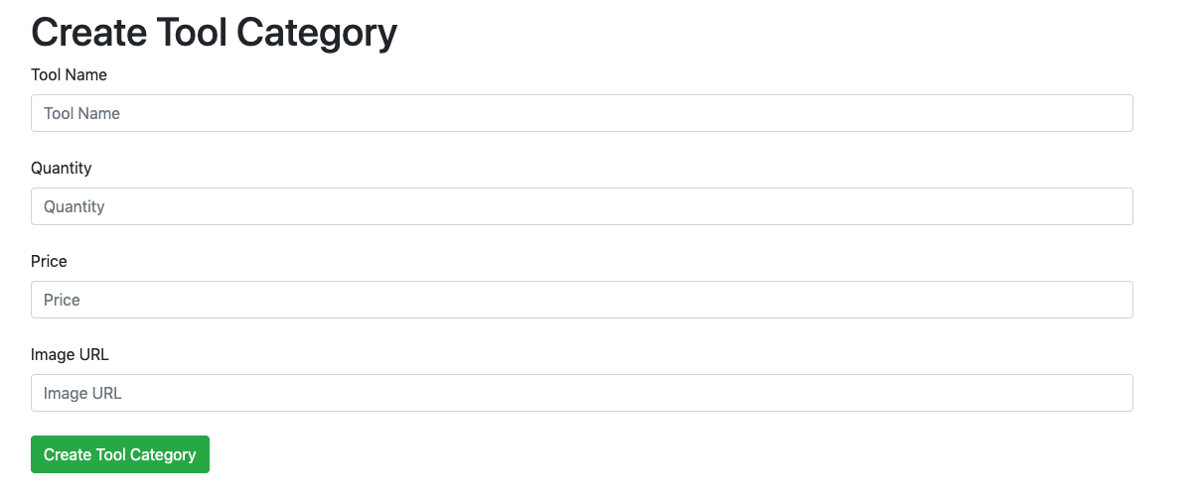
Requirement 2
Itemized work:
Connor
Model
Database
Tyler
Pages
Button
Mark
Testing
Karsten
Styling

Slide 14
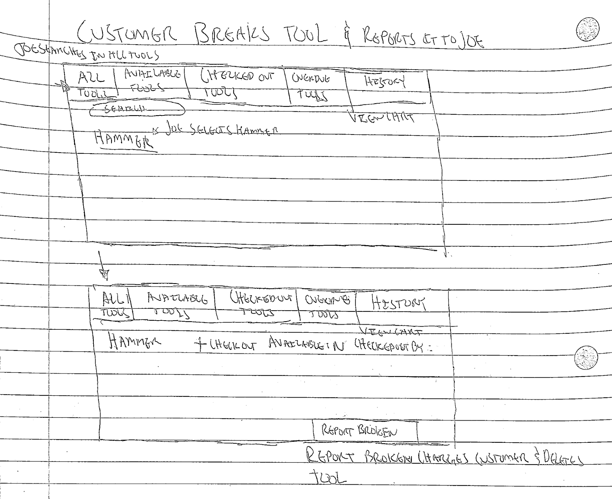
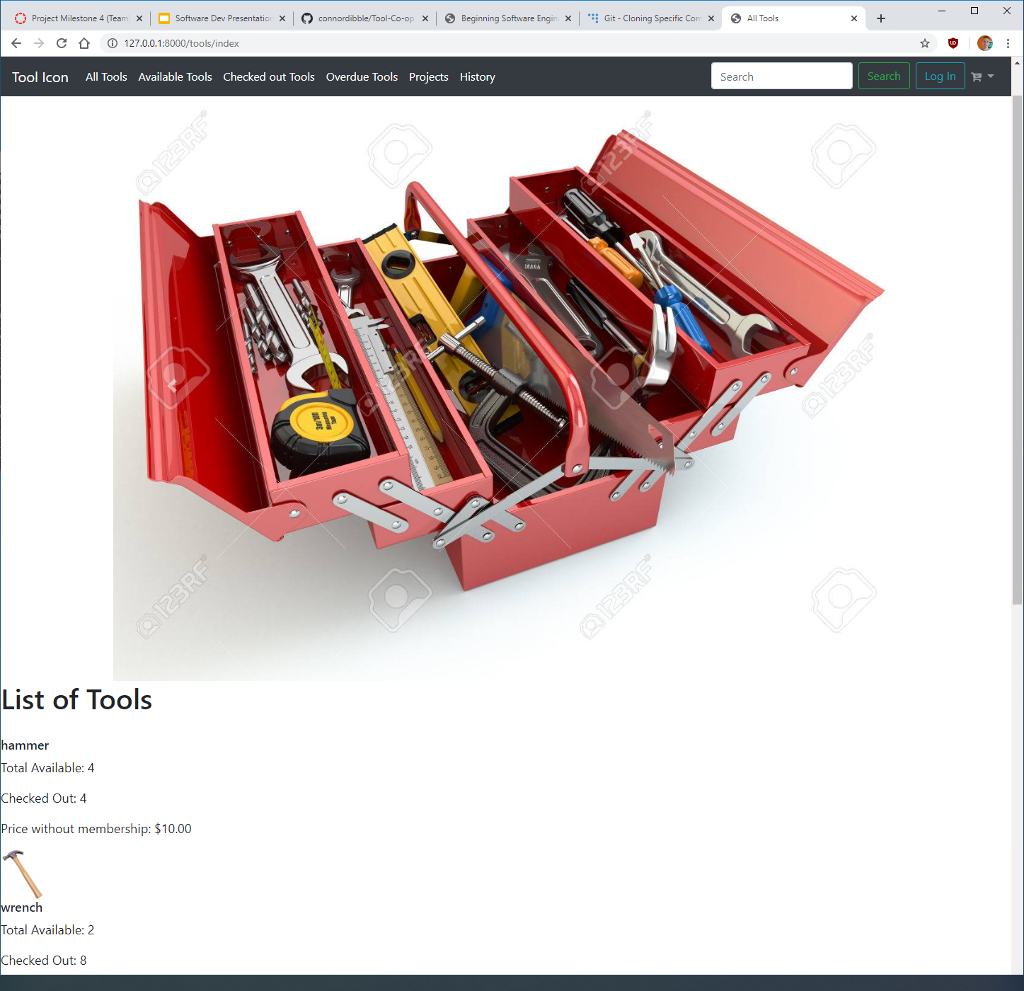
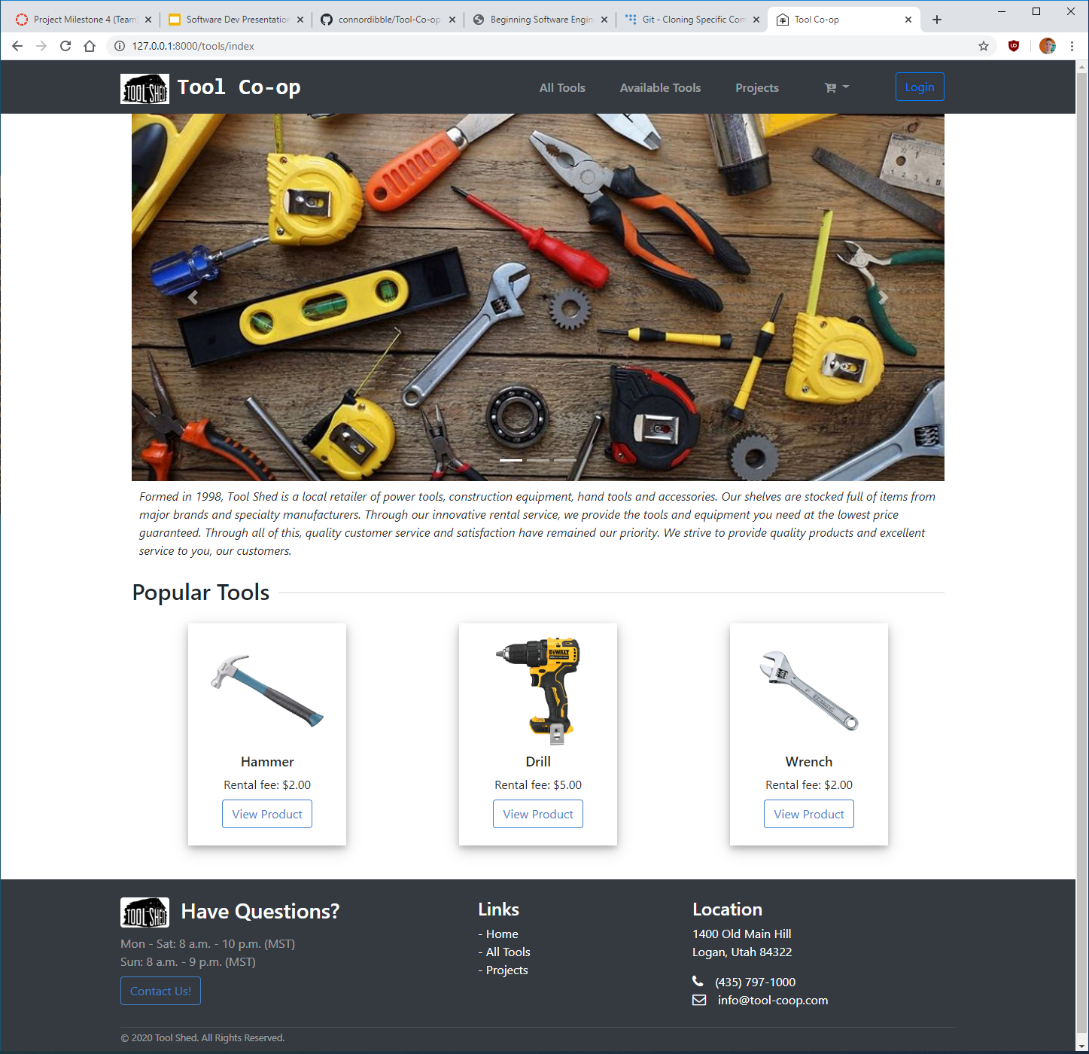
Styling the Application
“Style the website in a way that is straightforward and easy to use.”
This requirement began as a ‘should’ in the MOSCOW approach, but as the application shifted to be more front-end, it quickly became a ‘must’.
This is a non-functional requirement.
We categorized this requirement under ‘usability’ in the FURPS approach.
Documentation
This requirement can be tracked in our Requirements Definition, our Sprint Planning notes, the Scrum Board (see Milestone 3 all sprints), and in our Github Backlog (issues 21 and 78).
Low-fi Prototype
High-fi Prototype
Final Product

Slide 15
Styling the Application
Design
When the project began the concept we were given by Joe revolved around a very simple tool ordering database. Joe needed to digitize his customer logs and track the status of tools he was renting in a more efficient way. Our design changes over the course of the milestones reflect the expanding requirements Joe gave us, as well as us reaching our initial goals and stretching the project further.
We initially kept styling minimal - as a ‘should’ MOSCOW requirement - because a customer transaction database needed relatively little in terms of style so long as it was simple and organized. As the goal of the project shifted more to the front-end^{[1]}, we needed to accommodate the application to meet both customer use and employee use.
Design Choices
Utilize Django models and views to simplify all tool-related tasks.
Data can be entered using simple forms and submitted with the click of a button.
Organize content in a clear and concise way.^{[2]}
Separate employee and standard user utilities.
Have separate pages and content display if an employee is logged in, and hide such content if a user is not logged in.
Make the site consistent and aesthetically pleasing.
Create headers and footers, keep all content in a container that is consistent throughout any page on the site.
Notes:
[1] By front-end, we are referring to a ‘customer view’ of the website. Before, Joe would manually check out tools himself and the site needed to only be accessed by employees. Later, functionality for customers to check out tools online themselves needed to be added, as well as the additional requirement for a slideshow on the front page, so our view of the project needed to shift to accommodate the changes.
[2] We defined ‘clear and concise’ to be as simple structurally as we can get without losing any important information. Oversimplifying was a concern at the start. For example, a customer could have 5 tools checked out under their name, but only have the number of tools listed and not the types. While this is a lot more simple to store and display, Joe is losing important info about the customer transaction by doing so.

Slide 16
Styling the Application
Scrum Tasks
Pen and paper prototype - Feb 18, 2020 (Mark)
Added functionality to pages to display a message if database isn't present - Feb 20, 2020 (Connor)
Add Navbar/Footer - March 10, 2020 (Tyler)
Changed global navbar styling - Mar 12, 2020 (Karsten)
Added styling to tool displays - Mar 13, 2020 (Karsten)
Minor styling adjustments - Mar 13, 2020 (Karsten)
Organized authorized/unauthorized content - Mar 28, 2020 (Karsten)
Restyled checkout tab, footer, home page, history page, and other minor changes - Mar 28, 2020 (Karsten)
Fixed styling on the checkout cart dropdown - Apr 6, 2020 (Karsten)
Styled the checkout confirmation page - Apr 8, 2020 (Karsten)
Greyed out tools if they're unavailable - Apr 8, 2020 (Karsten)
Styled the history page - Apr 10, 2020 (Karsten)
Unit Testing
Styling and site organization did not require unit testing. Extensive human testing was done to make sure the site was consistent on each page.

Slide 17
Questions?
Resources:
Login/Logout Page. (n.d.). Retrieved from https://techwithtim.net/tutorials/django/login-logout/
Django Documentation. (n.d.). Retrieved from https://docs.djangoproject.com/en/3.0/
Bootstrap Documentation. (n.d.). Retrieved from https://getbootstrap.com/docs/4.0/getting-started/introduction/
Django Tutorial Part 10: Testing a Django web application. (n.d.). Retrieved from https://developer.mozilla.org/en-US/docs/Learn/Server-side/Django/Testing
Stephens, R. (2015). Beginning Software Engineering. Indianapolis, IN: Wrox. doi: 10.1002/9781119209515

